Slide 1
Meeting Report
Mosaic

Slide 2
Introduction
The problem of fragmented Android ecosystem makes user-interaction record and replay difficult.
So Mosaic is a cross-platform record and replay tool which is developed for solving this problem and it helps measuring performance between two devices easier.
Mosaic is a cross-platform, timing accurate user interaction record and replay tool for Android. ←也是結論

Slide 3
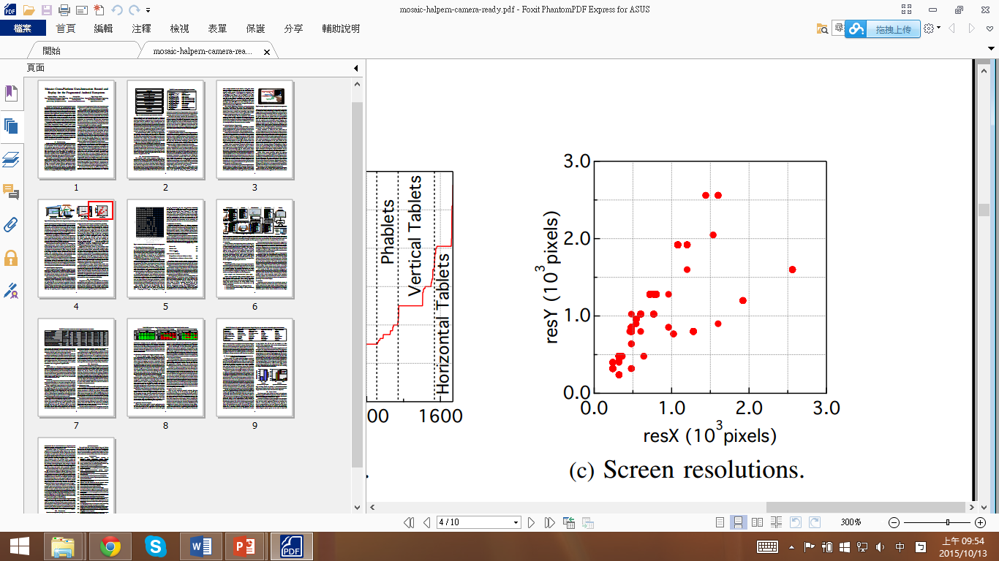
The fragmentation problem
Android Hardware Fragmentation
1. Screen Size
2. Orientation-portrait mode/landscape mode
3. Screen resolution(附圖)
4. Touchscreen Quantization

Slide 4
The fragmentation problem
Android Software Fragmentation
1. Touchscreen Driver-
Different touchscreen drivers pass different quantity or content of information to operating system.
2. Application Framework Version-
Different operating system versions expect different events from the touchscreen driver.
3. Virtual Soft Key

Slide 5
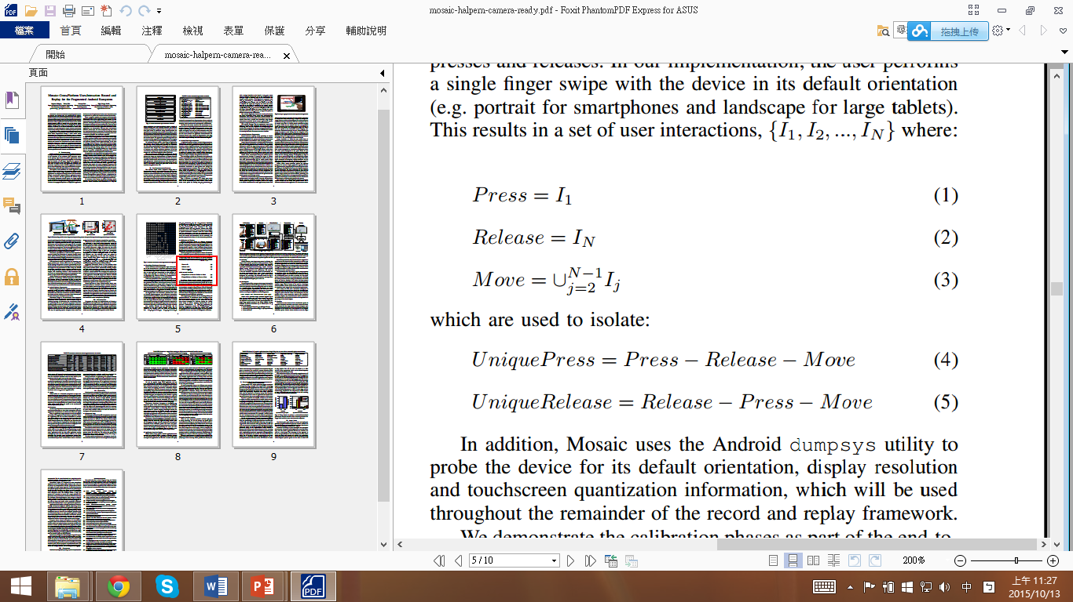
Mosaic Design
Formalizing Touchscreen Interaction
Define the set of interactions as {I₁,I₂,…,I_{N}}. I_{j}, for arbitrary j, correspond to individual “interaction primitive” and is composed of a set of events {e₁,e₂,…,e_{N}}, e_{N} is SYN_REPORT event.
Calibration and Training

Slide 6
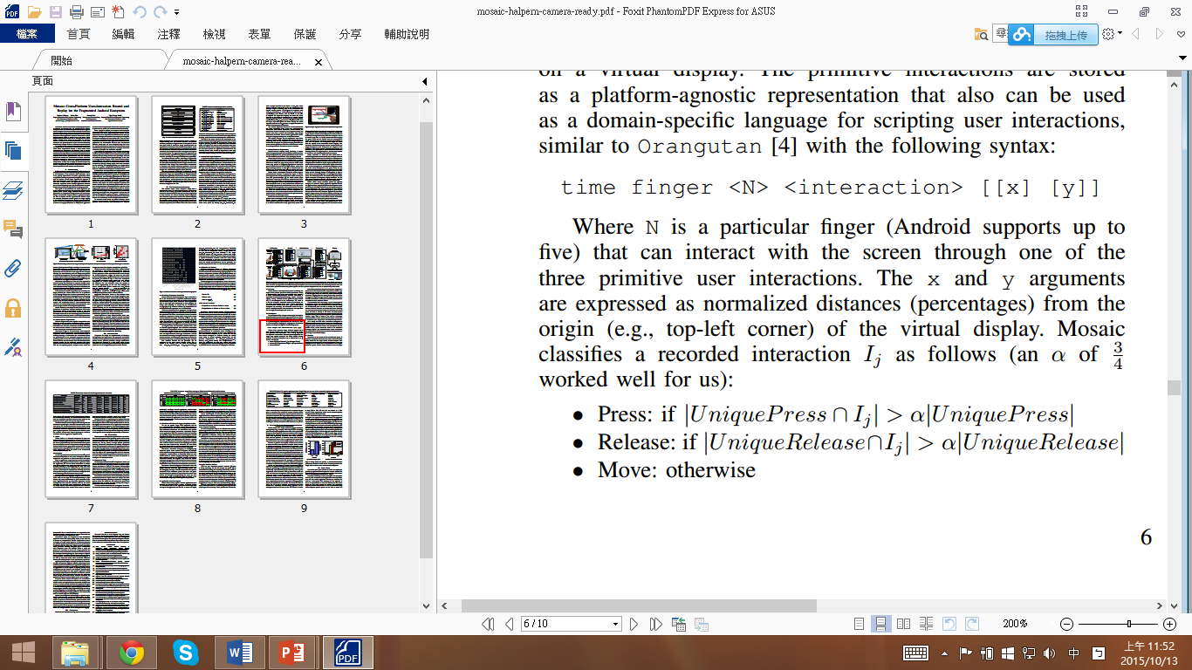
Mosaic Design
Recording
Mosaic only records input events that correspond to the device’s touchscreen. The result is a “file” containing a sequential stream of touchscreen input events.
Virtualization
The paper says that an α of ¾ works well. (But I wander why is ¾ rather than other number?)

Slide 7
Mosaic Design
Translate
Translation is the inverse of the virtualization phase. It maps the virtualized interaction trace into a stream of touchscreen events for the target device.
Replay
Mosaic generates the touchscreen event input sequence for the target platform and passes it to the RERAN replay utility, which writes the events to the touchscreen’s /dev/input/event file.
Limitation

Slide 8
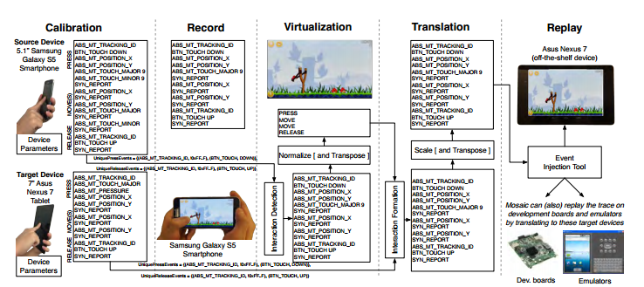
Mosaic Design

Slide 9
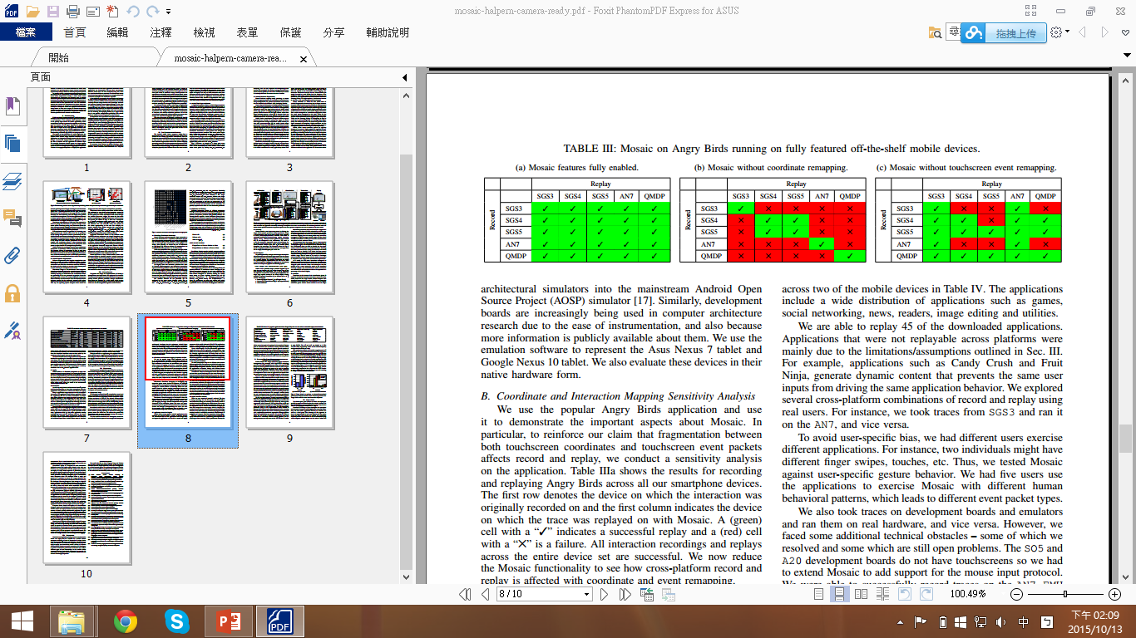
Evaluation
Coordinate and Interaction Mapping Sensitivity Analysis
1. Touchscreen Coordinate Remapping (Table IIIb)
2. Touchscreen Events remapping (Table IIIc)

Slide 10
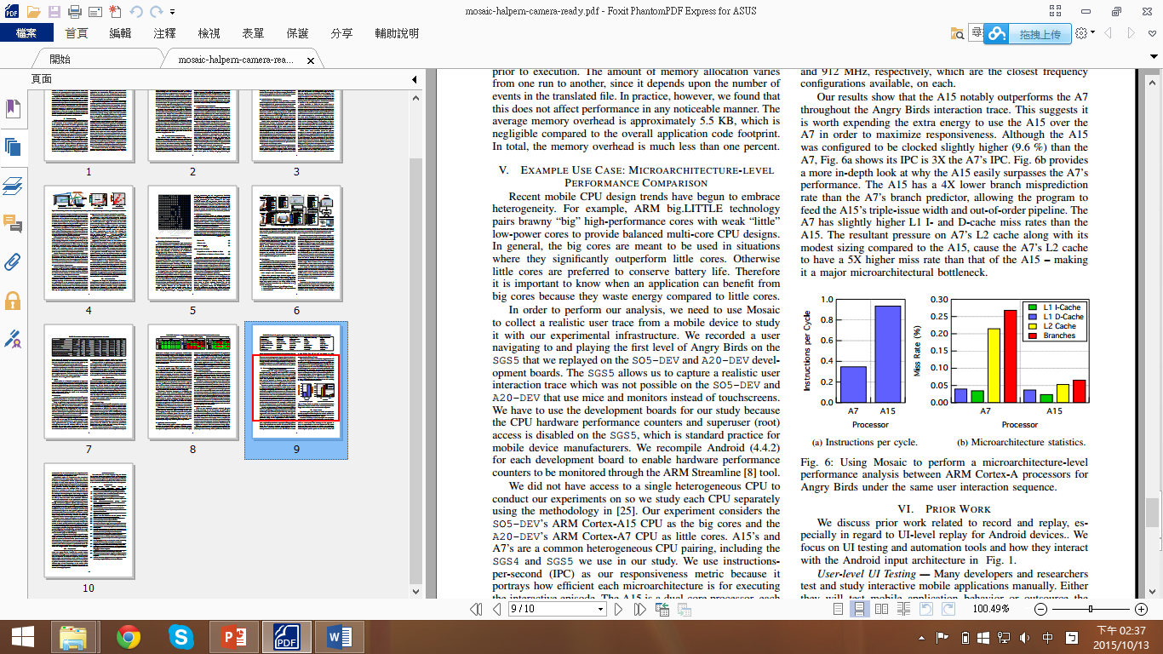
Evaluation
Replay Overhead Analysis
1. Overhead during recording: Low.
2. Overhead during replaying the recorded trace: Low.
Microarchitecture-Level Performance Comparison
The experiment considers the SO5-DEV’s ARM Cortex-A15 CPU as the big cores and the A20-DEV’s ARM Cortex-A7 CPU as little cores. And then compare performance between these two CPUs.
Result: A15 notably outperforms the A7.

